Slide 1
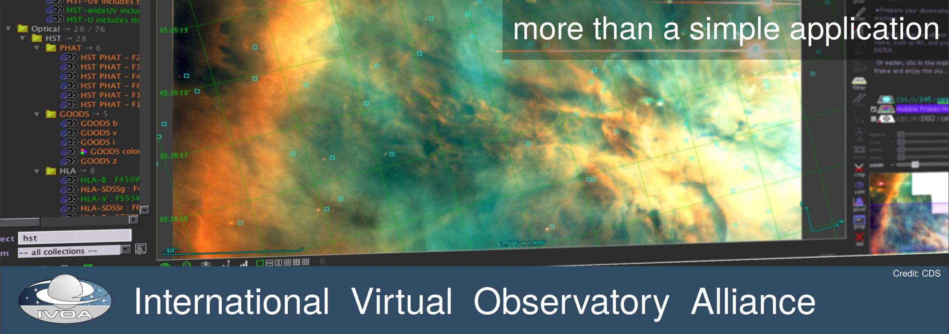
IVOA Media Group
Social media: Follow us and help spread the IVOA word! Interop: #ivoa19fr
Twitter: https://twitter.com/IVOAastro
Facebook: https://www.facebook.com/IVOAastro
Weibo (in chinese): https://m.weibo.cn/p/1005056397469427
Outreach: Handout material, templates, slides, stickers, examples, and the Corporate Design Document available at:
https://wiki.ivoa.net/twiki/bin/view/IVOA/MediaGroup

Slide 2
IVOA Media Group
Social media: Follow us and help spread the IVOA word! Interop: #ivoa19fr
Twitter: https://twitter.com/IVOAastro
Facebook: https://www.facebook.com/IVOAastro
Weibo (in chinese): https://m.weibo.cn/p/1005056397469427
Outreach: Handout material, templates, slides, stickers, examples, and the Corporate Design Document available at:
https://wiki.ivoa.net/twiki/bin/view/IVOA/MediaGroup
Newsletter: Send articles for the next IVOA newsletter, deadline: 5th June 19 Send to: ivoa-news-editors@ivoa.net
Contact us media@ivoa.net + New members welcome!!

